Slide 1
Chapter : Process Synchronization

Slide 2
Process Synchronization
Background
The Critical-Section Problem
Peterson’s Solution
Synchronization Hardware
Semaphores
Classic Problems of Synchronization
Monitors
Synchronization Examples
Atomic Transactions

Slide 3
Background
Co-Operating Process: that can affect or be affected by other processes executing in system
Concurrent access to shared data may result in data inconsistency
Process Synchronization: Ensures coordination among processes and maintains Data Consistency
Process P1 Process P2
1. X=5
2. X=5+2
1. read(x);
2. x=x+5;
3. Printf( x);

Slide 4
Producer Consumer Problem
There can be two situations:
Producer Produces Items at Fastest Rate Than Consumer Consumes
Producer Produces Items at Lowest Rate Than Consumer Consumes

Slide 5
Producer Consumer Problem
Producer Produces Items at Fastest Rate Than Consumer Consumes:
If Producer produces items at fastest rate than Consumer consumes Then Some items will be lost
Eg. Computer → Producer
Printer → Consumer

Slide 6
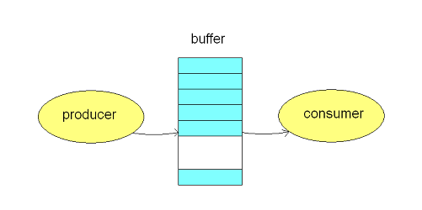
Producer Consumer Problem
Solution:
To avoid mismatch of items Produced or Consumed → Take Buffer
Idea is: Instead of sending items from Producer to Consumer directly→ Store items into buffer

Slide 7
Producer Consumer Problem
Buffer Can be:
Unbounderd Buffer:
  No buffer size limit
  Any no. of items can be stored
  Producer can produce on any rate, there will always be space in buffer
Bounderd Buffer:
  Limited buffer size

Slide 8
Producer Consumer Problem
Bounderd Buffer:
If rate of Production > rate of Consumption:
Some items will be unconsumed in buffer
If rate of Production < rate of Consumption:
At some time buffer will be empty

Slide 9
Producer
while (true) {
/* produce an item and put in nextProduced */
while (count == BUFFER_SIZE)
; // do nothing
buffer [in] = nextProduced;
in = (in + 1) % BUFFER_SIZE;
count++;
}

Slide 10
Consumer
while (true) {
while (count == 0) // buffer empty
{
; // do nothing
}
nextConsumed = buffer[out];
out = (out + 1) % BUFFER_SIZE;
count- -;
/* consume the item in nextConsumed
}

Slide 11
count=0 → buffer is empty
Producer
count=count+1
1. R1=count
2. R1=R1+1
3. Count = R1
Consumer
count=count-1
4. R2=count
5. R2=R2-1
6. Count = R2
Order of execution is not defined: May be
1→ 2→ 4→ 5→ 3→ 6

Slide 12
Race Condition
When multiple processes access and manipulate the same data at the same time, they may enter into a race condition.
Race Condition: When output of the process is dependent on the sequence of other processes.
Race Condition occurs when processes share same data
Process P1 Process P2
1. reads i=10
2. i=i+1 =11
PI got INTERRUPTED
1. P2 reads i=11 from memory 2. i=i+1 = 12
3. Stores i=11 in memory 3. Stores 12 in memory

Slide 13
Critical Section Problem
Section of code or set of operations, in which process may be changing shared variables, updating common data.
A process is in the critical section if it executes code that manipulate shared data and resources.
Each process should seek permission to enter its critical section→ Entry Section
Exit Section
Remainder section: Contains remaining code

Slide 14
Structure of a process
Repeat
{
// Entry Section
Critical Section
// Exit Section
Remainder Section
} until false.

Slide 15
Solution to: Critical Section
1. Mutual Exclusion:
It states that if one process is executing in its critical section, then no other process can execute in its critical section.
2. Bounded Wait:
It states that if a process makes a request to enter its critical section and before that request is granted, there is a limit on number of times other processes are allowed to enter that critical section.
Pi made request for Critical Section
Pj is already executing in its Critical Section…… Pi has to wait

Slide 16
Solution to: Critical Section
3. Progress:
It states that process cannot stop other process from entering their critical sections, if it is not executing in its CS.
Decision of entry into Critical Section is made by→ Processes in Entry Section
How? →→→ Set Lock in Entry Section
Once process leaves C.S, Lock is released (i.e in Exit Section)

Slide 17
Solution to: Critical Section
3. Progress:
N processes share same Critical Section
Decision about which process can enter the Critical Section is based on Processes which are interested to enter the C.S
(i.e. Processes of Entry Section)
Processes that do not want to execute in CS should not take part in decision

Slide 18
S/w Approaches/Solutions For C.S
Consider a Shared Variable, that can take 2 values 0 and 1
If (shared variable == 0)
P0 can enter to Critical Section
If (shared variable == 1)
P1 can enter to Critical Section

Slide 19
S/w Approaches/Solutions For C.S
Let turn=0
P0 | P1
While (1) { While(turn !=0);// if true process will be stuck in the loop CS turn= 1; } | While (1) { While(turn !=1);// if true process will be stuck in the loop CS turn= 0; }

Slide 20
S/w Approaches/Solutions For C.S
Mutual Exclusion satisfied
Progress
Now, Turn =1 i.e. process P1 can enter C.S.
But
Suppose P1 does not want to enter C.S.
So.. turn =1 is never set
Strict alteration is there.
Progress is not satisfied

Slide 21
2nd S/W Approach
Instead of one shared variable.
Assume a flag can be true or false.
If p0 wants to enter into CS it will set its flag true and when it doesn’t want to enter flag will be false.

Slide 22
2nd S/W Approach
P0 | P1
While(1) { Flag[0]=true; while(Flag[1]); CS Flag[0]=false; } | While(1) { Flag[1]=true; while(Flag[0]); CS Flag[1]=false; }

Slide 23
2nd S/W Approach
Follows mutual exclusion
Doesn’t follow progress
System may go into deadlock state.

Slide 24
Peterson’s Solution
Two process solution
The two processes share two variables:
  int turn;
  Boolean flag[2]
The variable turn indicates whose turn it is to enter the critical section.
The flag array is used to indicate if a process is ready to enter the critical
section. flag[i] = true implies that process P_{i} is ready!

Slide 25
Algorithm for Peterson’s solution
P0 | P1
While(1) { Flag[0]=true; turn=1; while(turn==1 && flag[1]==true); CS Flag[0]=false; } | While(1) { Flag[1]=true; turn=0; while(turn==0 && flag[0]==true); CS Flag[1]=false; }

Slide 26
Mutual exclusion satisfied.
Progress satisfied.
Bounded wait satisfied.

Slide 27
Synchronization Hardware
Hardware Solution to C.S.
Many systems provide hardware support for critical section code
Uniprocessors – could disable interrupts
  Currently running code would execute without preemption
Disabling interrupt in multiprocessor environment can be time consuming , as message is passed to all the processors.
Modern machines provide special atomic hardware instructions
    Atomic = non-interruptable
  Either test memory word and set value
  Or swap contents of two memory words

Slide 28
Hardware Solution to C.S.
Interrupt Disabling
In Single CPU system, processes do not execute in parallel
Process leaves control of CPU when it is interrupted.
Solution is:
  To have each process disable all interrupts just after entering to the critical section.
  Re-enable interrupts after leaving critical section

Slide 29
Hardware Solution to C.S.
Interrupt Disabling
Repeat
Disable interrupts
C.S
Enable interrupts
Remainder section

Slide 30
Hardware Solution to C.S.
Hardware instructions
Machines provide inst. That can read, modify and store memory word
Common inst. are:
  Test and Set
  This inst. Provides action of testing a variable and set its value
  It executes atomically
  Test and Set instructions operates on single Boolean variable.

Slide 31
TestAndndSet Instruction
Definition:
boolean TestAndSet (boolean *target)
{
boolean rv = target;
*target = TRUE;
return rv:
}

Slide 32
Solution using TestAndSet
Shared Boolean variable lock., initialized to false.
Solution:
Test and Set definition
boolean TestAndSet (boolean *lock) { boolean init = lock; lock= TRUE; return init; } | while (true) { while ( TestAndSet (&lock )); // critical section lock = FALSE; // remainder section }

Slide 33
Swap Instruction
Definition:
void Swap (boolean *a, boolean *b)
{
boolean temp = *a;
*a = *b;
*b = temp:
}

Slide 34
Solution using Swap
Shared Boolean variable lock initialized to FALSE; Each process has a local Boolean variable key.
Solution:
Definition
void Swap (boolean *a, boolean *b) { boolean temp = *a; *a = *b; *b = temp: } | while (true) { key = TRUE; while ( key == TRUE) { Swap (&lock, &key ); } // critical section lock = FALSE; // remainder section }

Slide 35
Bounded waiting mutual exclusion with TestAndSet
do
{ waiting[i] = true;
key = true;
while (waiting[i] && key)
key = test_and_set(&lock);
waiting[i] = false;
/* critical section */
j = (i + 1) % n;
while ((j != i) && !waiting[j])
j = (j + 1) % n;
if (j == i)
lock = false;
else waiting[j] = false; /* remainder section */
}
while (true);

Slide 36
Semaphore
Semaphore S – integer variable
Two standard operations modify S: wait() and signal()
  Originally called P() and V()
Less complicated
Can only be accessed via two indivisible (atomic) operations
  wait (S) {
  while S <= 0
  ; // no-op
  S--;
  }
  signal (S) {
  S++;
  }

Slide 37
We can use semaphore to solve various synchronization problem.
Let P1 and P2 are two process
P1 wants to execute S1 statement. And P2 wants to execute S2 statement.
S1 is to be executed before S2
S1;
Signal(synch);
Wait(synch);
S2

Slide 38
Semaphore as General Synchronization Tool
Counting semaphore – integer value can range over an unrestricted domain
Binary semaphore – integer value can range only between 0
and 1; can be simpler to implement
  Also known as mutex locks
Can implement a counting semaphore S as a binary semaphore
Provides mutual exclusion
  Semaphore S; // initialized to 1
  wait (S);
  Critical Section
  signal (S);

Slide 39
Semaphore Implementation
Must guarantee that no two processes can execute wait () and signal () on the same semaphore at the same time.
Thus, implementation becomes the critical section problem where the wait and signal code are placed in the crtical section.
  Could now have busy waiting in critical section implementation
    But implementation code is short

Slide 40
Semaphore Implementation with no Busy waiting
With each semaphore there is an associated waiting queue. Each entry in a waiting queue has two data items:
  value (of type integer)
  pointer to next record in the list
Two operations:
  block – place the process invoking the operation on the appropriate waiting queue.
  wakeup – remove one of processes in the waiting queue and place it in the ready queue.

Slide 41
Semaphore Implementation with no Busy waiting (Cont.)
Implementation of wait:
wait (S){
value--;
if (value < 0) {
add this process to waiting queue
block(); }
}
Implementation of signal:
Signal (S){
value++;
if (value <= 0) {
remove a process P from the waiting queue
wakeup(P); }
}

Slide 42
Deadlock and Starvation
Deadlock – two or more processes are waiting indefinitely for an event that can be caused by only one of the waiting processes
Let S and Q be two semaphores initialized to 1
P₀ P₁
wait (S); wait (Q);
wait (Q); wait (S);
. .
. .
. .
signal (S); signal (Q);
signal (Q); signal (S);
Starvation – indefinite blocking. A process may never be removed from the semaphore queue in which it is suspended.

Slide 43
Classical Problems of Synchronization
Bounded-Buffer Problem
Readers and Writers Problem
Dining-Philosophers Problem

Slide 44
Bounded-Buffer Problem
N buffers, each can hold one item
Semaphore mutex initialized to the value 1
Semaphore full initialized to the value 0
Semaphore empty initialized to the value N.

Slide 45
Bounded Buffer Problem (Cont.)
The structure of the producer process
while (true) {
// produce an item
wait (empty);
wait (mutex);
// add the item to the buffer
signal (mutex);
signal (full);
}

Slide 46
Bounded Buffer Problem (Cont.)
The structure of the consumer process
while (true) {
wait (full);
wait (mutex);
// remove an item from buffer
signal (mutex);
signal (empty);
// consume the removed item
}

Slide 47
Readers-Writers Problem
A data set is shared among a number of concurrent processes
  Readers – only read the data set; they do not perform any updates
  Writers – can both read and write.
Problem – allow multiple readers to read at the same time. Only one single writer can access the shared data at the same time.
Shared Data
  Data set
  Semaphore mutex initialized to 1.
  Semaphore wrt initialized to 1.
  Integer readcount initialized to 0.

Slide 48
Readers-Writers Problem (Cont.)
The structure of a writer process
while (true) {
wait (wrt) ;
// writing is performed
signal (wrt) ;
}

Slide 49
Readers-Writers Problem (Cont.)
The structure of a reader process
while (true) {
wait (mutex) ;
readcount ++ ;
if (readcount == 1) wait (wrt) ;
signal (mutex)
// reading is performed
wait (mutex) ;
readcount - - ;
if (readcount == 0) signal (wrt) ;
signal (mutex) ;
}

Slide 50
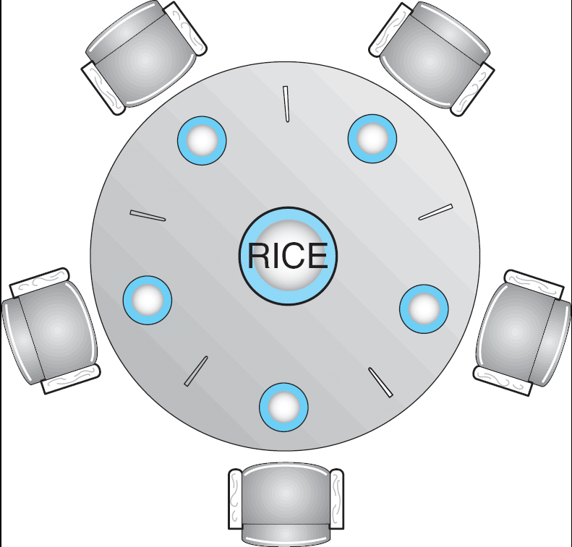
Dining-Philosophers Problem
Shared data
  Bowl of rice (data set)
  Semaphore chopstick [5] initialized to 1

Slide 51
Dining-Philosophers Problem (Cont.)
The structure of Philosopher i:
    While (true) {
    wait ( chopstick[i] );
    wait ( chopStick[ (i + 1) % 5] );
    // eat
    signal ( chopstick[i] );
    signal (chopstick[ (i + 1) % 5] );
    // think
    }

Slide 52
Problems with Semaphores
Incorrect use of semaphore operations:
  signal (mutex) …. wait (mutex)
  wait (mutex) … wait (mutex)
  Omitting of wait (mutex) or signal (mutex) (or both)

Slide 53
Monitors
A high-level abstraction that provides a convenient and effective mechanism for process synchronization
Only one process may be active within the monitor at a time
    monitor monitor-name
    {
    // shared variable declarations
    procedure P1 (…) { …. }
    …
    procedure Pn (…) {……}
    Initialization code ( ….) { … }
    …
    }
    }

Slide 54

Schematic view of a Monitor

Slide 55
Condition Variables
condition x, y;
Two operations on a condition variable:
  x.wait () – a process that invokes the operation is
  suspended.
  x.signal () – resumes one of processes (if any) that
  invoked x.wait ()

Slide 56

Monitor with Condition Variables

Slide 57
Solution to Dining Philosophers
monitor DP
{
enum { THINKING; HUNGRY, EATING) state [5] ;
condition self [5];
void pickup (int i) {
state[i] = HUNGRY;
test(i);
if (state[i] != EATING) self [i].wait;
}
void putdown (int i) {
state[i] = THINKING;
// test left and right neighbors
test((i + 4) % 5);
test((i + 1) % 5);
}

Slide 58
Solution to Dining Philosophers (cont)
void test (int i) {
if ( (state[(i + 4) % 5] != EATING) &&
(state[i] == HUNGRY) &&
(state[(i + 1) % 5] != EATING) ) {
state[i] = EATING ;
self[i].signal () ;
}
}
initialization_code() {
for (int i = 0; i < 5; i++)
state[i] = THINKING;
}
}

Slide 59
Solution to Dining Philosophers (cont)
Each philosopher I invokes the operations pickup()
and putdown() in the following sequence:
dp.pickup (i)
EAT
dp.putdown (i)

Slide 60
Monitor Implementation Using Semaphores
Variables
semaphore mutex; // (initially = 1)
semaphore next; // (initially = 0)
int next-count = 0;
Each procedure F will be replaced by
wait(mutex);
…
body of F;
…
if (next-count > 0)
signal(next)
else
signal(mutex);
Mutual exclusion within a monitor is ensured.

Slide 61
Monitor Implementation
For each condition variable x, we have:
semaphore x-sem; // (initially = 0)
int x-count = 0;
The operation x.wait can be implemented as:
x-count++;
if (next-count > 0)
signal(next);
else
signal(mutex);
wait(x-sem);
x-count--;

Slide 62
End of Chapter 6

